Slide 1
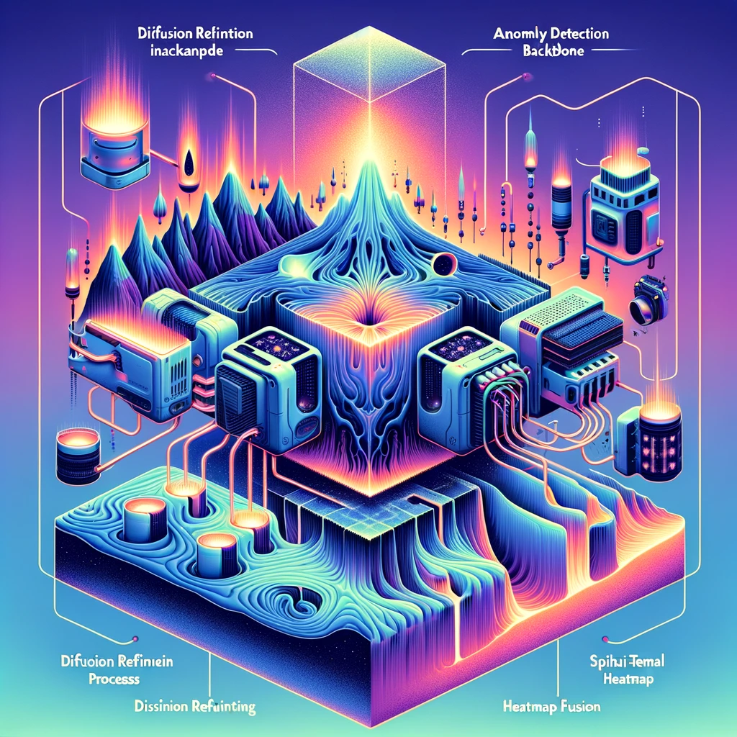
Enhancing Multi Class Anomaly Detection through Diffusion Refinement
Paper review
Gibeom Kim (UST)
Notes:
Before start the presentation, I apologize if my presentation is not as smooth as it could be due to covid-19

Slide 2
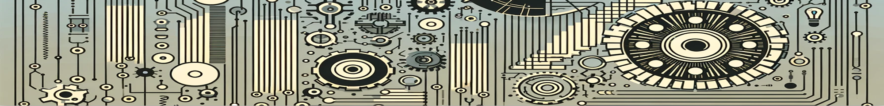
Index
Paper abstract
1-1. Identical shortcuts
Model
Conclusion

Slide 3
1. Paper abstract
Anomaly detection method can be broadly categorized into three primary approaches:
By using pretrained CNN models, extract features of images and compare it. (ex. PaDiM, PatchCore)
Apply image reconstruction techniques, reconstruct images and detects anomalies based on the reconstruction error. (ex. DDAD)
Use deep neural networks specifically trained to distinguish between normal and anomalous samples. (ex. EfficientAD)
A model that integrates the first and second approaches for multi-class prediction
Reducing the “Identical shortcuts" problem

Slide 4
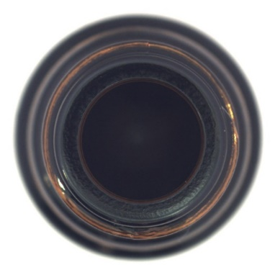
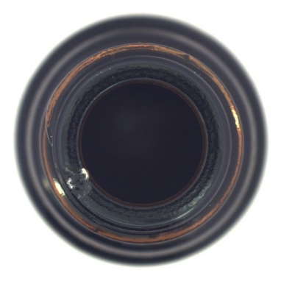
1-1. Identical shortcuts
The problem occurred when reconstruct image from input image
If there is defect in input image, model should generate very different image from input image
But the model is trained to generate output image just same as input image for reducing reconstruction loss
<Normal case>
<Abnormal case>
Input image
Output image
Input image
Output image

Slide 5
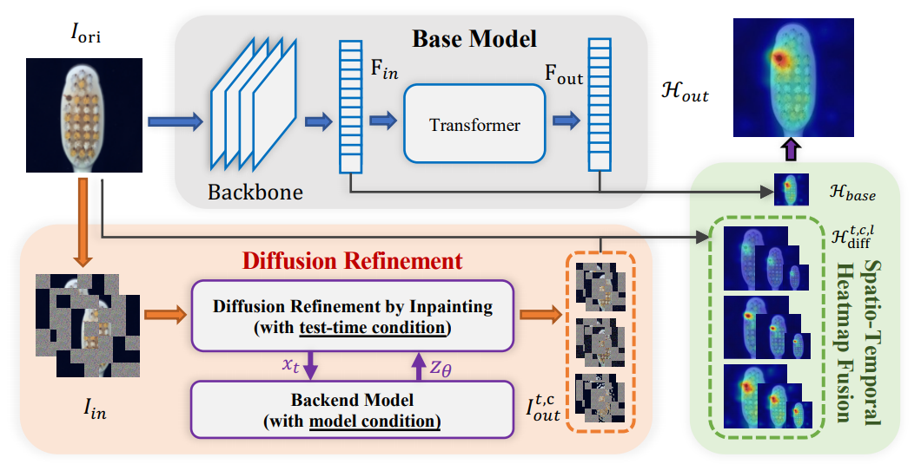
1. Paper Abstract

Slide 6
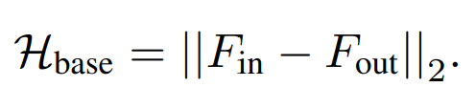

2. Model
Base model
Original image $I_{ori}$ is inputted to pretrained cnn model(ex. EfficientNet-b4) and get embbeding vector $F_{in}$
Use $F_{in}$ to recover output feature generated by the transformer network
$H_{base}$ is calculated by L2 distance of $F_{in}, F_{out}$
Notes:
Mean square error loss

Slide 7
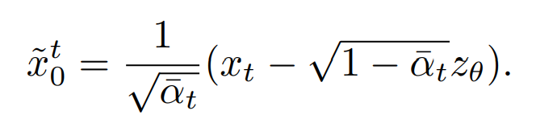
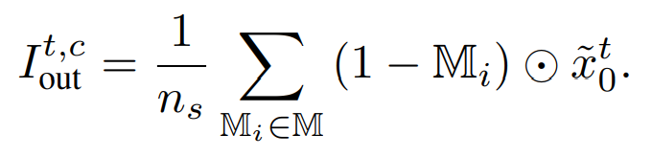
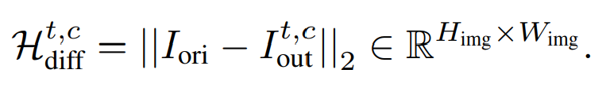
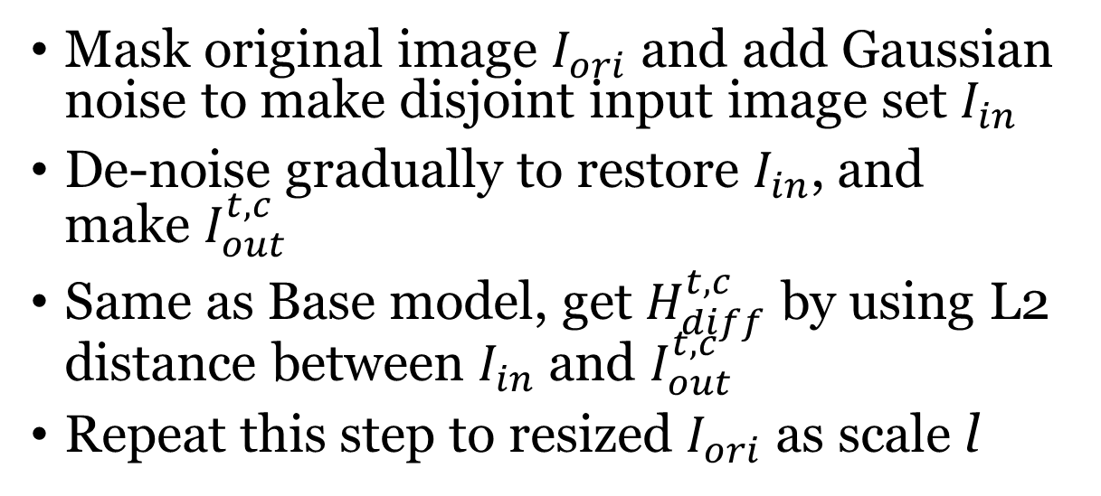


2. Model
Diffusion Refinement
Mask original image $I_{ori}$ and add Gaussian noise to make disjoint input image set $I_{in}$
De-noise gradually to restore $I_{in}$, and make $I_{out}^{t,c}$
Same as Base model, get $H_{diff}^{t,c}$ by using L2 distance between $I_{in}$ and $I_{out}^{t,c}$
Repeat this step to resized $I_{ori}$ as scale l
$x_{t}$: input image added gaussian noise
t: time step
c: inpainting grid size
$z_{θ}$: predicted noise of $x_{t}$
${\overline{α}}_{t}$: total noise accumulated to get to time step t
$I_{out}^{t,c}$: output image of time step t
${\tilde{x}}_{0}^{t}$: de-noised image about predicted noise $z_{θ}$at time step t
$M_{i}$: i-th masked image of disjoint image set
Notes:
You can see that the masked area and the area in the original image do not match.
Inversion=반전
Indicates how to recover an image xt certain time step t in the backward diffusion process.
Recovering only the unmasked areas and averaging them to create the final output image
Used to detect anomalies through differences between original and recovered images

Slide 8

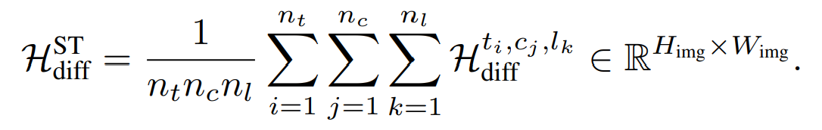
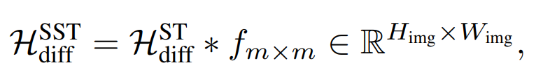
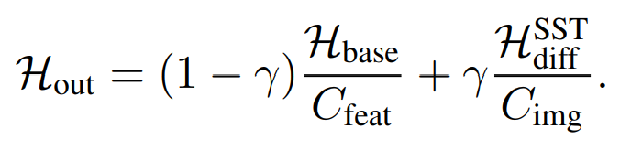
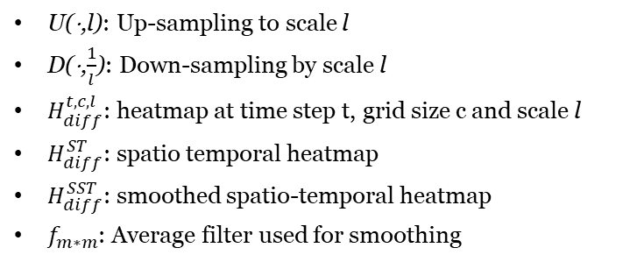

2. Model
Spatio-temporal Heatmap Fusion
Average all generated heatmaps from diffusion refinement and make unified heatmap $H_{diff}^{SST}$
Apply smoothing process to unified heatmap to reduce noise and clarify the result
Average heatmap from Base Model $H_{base}$ and unified heatmap $H_{diff}^{SST}$
U(⋅,l): Up-sampling to scale l
D(⋅,$\frac{1}{l}$): Down-sampling by scale l
$H_{diff}^{t,c,l}$: heatmap at time step t, grid size c and scale l
$H_{diff}^{ST}$: spatio temporal heatmap
$H_{diff}^{SST}$: smoothed spatio-temporal heatmap
$f_{m∗m}$: Average filter used for smoothing

Slide 9
3. Conclusion
Applied a diffusion model specialized for inpainting tasks to avoid the "identical shortcuts" issue.
Enhanced clarity and detail of the original heatmap by reconstructing only the high-frequency components.
Introduced dual conditions(category-awareness, spatio-temporal fusion) suitable for multi-class anomaly detection settings.

Slide 10
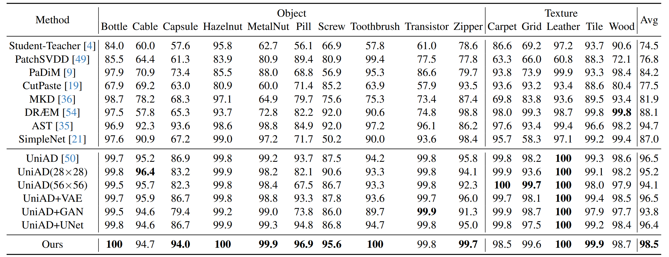
3. Conclusion

Slide 11
Thank you

